Slide 2
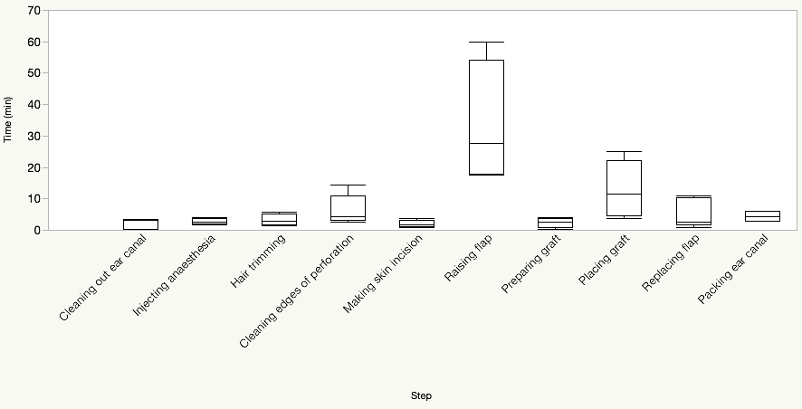
Duration of Steps in Endoscopic Tympanoplasty
Mean = 33.2
Std Dev = 19.8
Mean = 13.0
Std Dev = 8.6
Mean = 4.5
Std Dev = 2.1
Mean = 4.9
Std Dev = 4.4
Mean = 3.3
Std Dev = 1.9
Mean = 2.4
Std Dev = 1.6
Mean = 4.4
Std Dev = 1.5
Mean = 2.3
Std Dev = 1.7
Mean = 2.7
Std Dev = 1.0
Mean = 2.0
Std Dev = 1.2

